Slide 1
WorkFam Leave Survey 2016-17
Trends and findings

Slide 2
Background information
Hosted on Survey Monkey
Publicized to SMT and AMS
140 responses over 6 months (4 October 2016 - 25 April 2017)
Roughly equal representation between SMT and AMS
SMT………55%
AMS………60%

Slide 3
Who responded?
More women than men
Female………60%
Male…………39%
Equal representation between tenured and untenured faculty; few students
Tenured………44%
Untenured………44%
ABD………3%

Slide 4
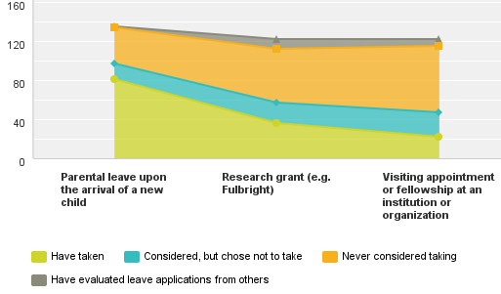
Most common leave is parental leave.

Slide 5
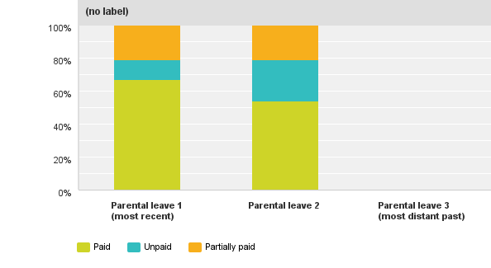
Profile of Parental Leave (income)
Stop at two? ☺
First leave most likely to be fully paid. Second leave less paid.
Comments reveal a variety of ways to work around restrictive institutional leave policies.

Slide 6
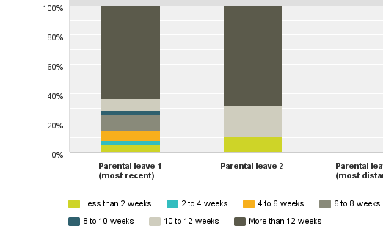
Profile of Parental Leave (duration)
Majority take more than 12 weeks off.
Greater variety of durations for first leave.
Second leave duration more extreme in distribution.

Slide 7
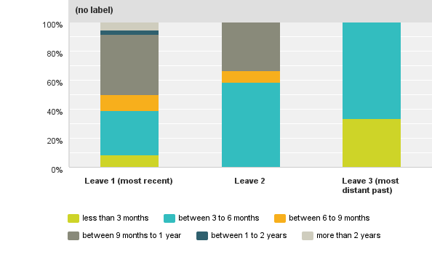
Profile of Research Leave
Those who take research leaves don’t stop at two. ☺
Greater variety of durations for first leave.
Second leave usually 1 or 2 semesters.
Third leave much shorter.

Slide 8
Gender & Organizational Leave Trends
Current demographics:
SMT 2016 (65% male, 34% female)
AMS 2017 (51% female, 49% male)
More men in SMT have taken parental leave.
SMT: 43% (18 males) vs. 57% female
AMS: 21% (8 males) vs 79% female
Gender equality in SMT for research leave, more women in AMS
SMT: 5 females, 6 males
AMS: 16 females, 8 males
Gender equality in SMT for visiting positions, more men in AMS
SMT: 4 males, 4 females
AMS: 6 males, 4 females

Slide 9
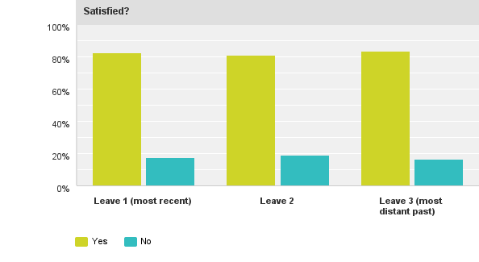
Are we satisfied?
Generally, yes.
Sources of dissatisfaction: collegial/student demands, too short, threatened job security, negotiating with administrators, pay cut, fathers who use parental leave for research/writing, limited options for non-tenure-trackers.

Slide 10
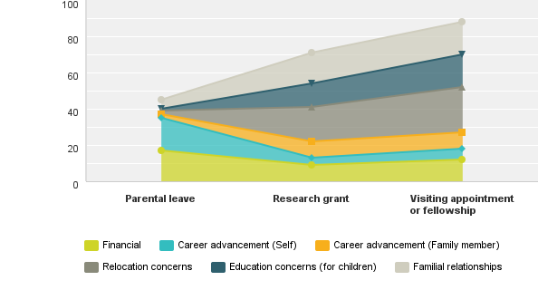
Why we don’t take leave
Parental leave different from research leave/visiting position.
Parental leave: income loss, own career advancement.
Research leave/visiting position: relocation, family, children.

